Slide 1

OOPS THROUGH C++ | PROJECT REVIEW – II
RAILWAY RESERVATION SYSTEM
TEAM NO : 02
Presented By
25B11AI220 — CH SIVA RAMA TEJA
25B11AI394 — G. LEELA DURGA
25B11AI372 — G SRITHAN GUPTA
26B21AI031 — G.A.V. SAI RAM GUPTHA
Under the esteemed guidance of
Mr. V. Appalakonda
M.Tech (Ph.D), Assistant Professor (AIML)
24-09-2026 PBL Course Name: Object Oriented Programming through C++ (2501CS08) FINAL REVIEW

Slide 2

Introduction
1
Reservation management involves trains, passengers, and ticket bookings.
2
Manual management of these records can be difficult.
3
Our project provides a computerized solution using C++.
4
It simplifies and organizes the railway reservation process.
24-09-2026
PBL Course Name: Object Oriented Programming through C++ (2501CS08)
2

Slide 3
Abstract
1
Console-based Railway Reservation System developed using C++
2
User Registration and Login
3
Train Search and Seat Availability
4
Ticket Booking, PNR Generation and Cancellation
5
Admin Module for Train and Reservation Management
6
File Handling for Data Storage without a Database
24-09-2026
PBL Course Name: Object Oriented Programming through C++ (2501CS08)
3

Slide 4
Problem Statement
Maintaining train, passenger, and booking records requires proper management.
Managing railway reservations manually is time-consuming and difficult.
PROBLEM
STATEMENT
Checking seat availability and updating bookings manually can lead to errors.
Managing ticket booking and cancellation requires an organized system.
24-09-2026
PBL Course Name: Object Oriented Programming through C++ (2501CS08)
4

Slide 5
Objectives
To develop a simple and efficient Railway Reservation System using C++.
1
To allow users to search for trains and check seat availability.
2
To simplify the ticket booking and cancellation process.
3
To manage train, passenger, and reservation details effectively.
4
To provide an organized and user-friendly reservation system.
5
24-09-2026
PBL Course Name: Object Oriented Programming through C++ (2501CS08)
5

Slide 6


Users of the System
Passengers / Users
Administrator
To search trains, check availability, book tickets, and cancel reservations.
To manage train details, reservations, and user records.
24-09-2026
PBL Course Name: Object Oriented Programming through C++ (2501CS08)
6

Slide 7
SYSTEM DESIGN
Modules / Functionalities
1
User Class
2
Train Class
3
Reservation Class
User Registration and Login
View and Manage User Profile
Add, Update, Delete, and View Train Details
Search for Available Trains
Check Seat Availability
Book Railway Tickets
Generate PNR Number
4
Ticket Class
6
Admin Class
7
File Management
View Ticket and PNR Status
Cancel Booked Tickets
Manage Train and Reservation Records
View System Reports
Store and Retrieve System Data Using Text Files
24-09-2026
PBL Course Name: Object Oriented Programming through C++ (2501CS08)
7

Slide 8
SYSTEM ARCHITECTURE
System Design Overview
PRESENTATION LAYER
Console / Menu-Driven User Interface
PROCESSING LAYER
C++ Application / Business Logic
STORAGE LAYER
Data Layer
users.txt
bookings.txt
User Data
Booking / Ticket Data
24-09-2026
PBL Course Name: Object Oriented Programming through C++ (2501CS08)
8

Slide 9
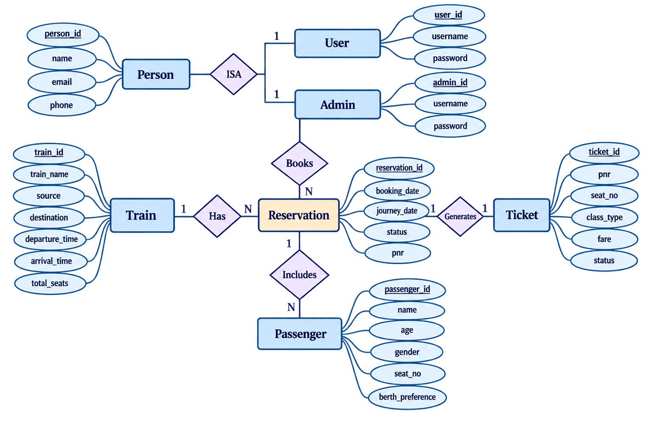
Entity–Relationship Diagram
24-09-2026
PBL Course Name: Object Oriented Programming through C++ (2501CS08)
9

Slide 10
C++ Concepts Used
Classes & Objects
Inheritance
Used to represent entities such as User, Train, Passenger, and Ticket.
User and Admin inherit common details from the Person class.
Encapsulation
Constructors
Data members and related functions are grouped inside classes, with access controlled using private, protected, and public.
Used to initialize objects with required values when they are created.
Arrays
Functions
Used to store multiple trains, users, and tickets in the railway system.
Used to divide the program into modules such as ticket booking, train search, PNR checking, and cancellation.
File Handling
Conditional Statements & Loops
ifstream and ofstream are used to save and load user and ticket data from files.
Used for menu operations, validation, searching, and repeated user interactions.
24-09-2026
PBL Course Name: Object Oriented Programming through C++ (2501CS08)
12

Slide 11
PROJECT PLAN
Planning & Timeline
W1
W2
W3
W4
W5
W6
W7
Requirement Analysis
System Design (Class / ER Diagrams)
Coding & Module Development
Integration & Testing
Documentation & Final Review
24-09-2026
PBL Course Name: Object Oriented Programming through C++ (2501CS08)
10

Slide 12
TEAM CONTRIBUTIONS
Role of Each Individual
ROLL NO | NAME | ROLE / RESPONSIBILITY
25B11AI372 | G SRITHAN GUPTA | Class design, Event & Registration modules
25B11AI220 | CH SIVA RAMA TEJA | Coding – core modules & file handling
26B21AI031 | G.A.V.SAI RAM GUPTHA | Testing, debugging & report generation
25B11AI394 | G.LEELA DURGA | UI design, documentation & presentation
24-09-2026
PBL Course Name: Object Oriented Programming through C++ (2501CS08)
11

Slide 13
Limitations & Future Enhancements
LIMITATIONS
FUTURE ENHANCEMENTS
Console-Based Interface – The system uses a text-based interface instead of a graphical interface.
Graphical User Interface (GUI) – Develop a user-friendly web or desktop interface.
Limited Train Data – The system currently contains a fixed number of trains and predefined routes.
Database Integration – Replace text files with MySQL or another database system.
Local File Storage – User and ticket details are stored in text files instead of a database.
Online Payment – Add secure online payment functionality for ticket booking.
No Online Payment – The system does not support real-time online payment processing.
Real-Time Railway Data – Integrate live train schedules and seat availability.
No Real-Time Updates – Train schedules, seat availability, and fares are not connected to live railway data.
Mobile Application – Develop an Android/iOS application for easier ticket booking.
24-09-2026
PBL Course Name: Object Oriented Programming through C++ (2501CS08)
13

Slide 14
THANK YOU
Railway Reservation System · Final Review
24-09-2026 · PBL Course Name: Object Oriented Programming through C++ (2501CS08)

